Slide 1
Arduino Course Spring 2014 Arduino 101
May 12, 2014
Tara Echlin

Slide 2
Overview
You will learn all the essentials of using an Arduino
Physical and electrical foundation
Programming & “Integrated Development Environment”
“Downloading” & running a program on Arduino
Basics of Arduino applications
Duration: 90 minutes
Break for dinner after Lesson X
Then, projects!
Instructor-provided laptops:
Do not connect these to APLNIS
Notes:
You will learn all the essentials of using an Arduino
Physical and electrical foundation
Programming & “Integrated Development Environment”
“Downloading” & running a program on Arduino
Basics of Arduino applications
Duration: 90 minutes
Followed by dinner and projects!
Instructor-provided laptops:
only Adobe Reader and MS Word reader exist
use notepad/wordpad to make notes if desired

Slide 3
Arduino Course Material
on Desktop:
Arduino 101 folder
Arduino 101 slides (Arduino101.pptx)
PDF files to be used in Arduino 101
Sketches folder
Adafruit Lesson Reference Material folder
contains PDFs, as well as original Adafruit ones for lessons we modified, schematics, and other dark secrets
Arduino IDE icon
Arduino Projects folder
Arduino IDE folder

Slide 4
Wired Network Information
There are network cables hanging from the ceiling.
Each of the jacks has a green port, which connects to APLNIS and a yellow port, which connects to the DMZ.
If you brought your own laptop, you will know which network it should be connected to.
If you were supplied with a laptop, that laptop cannot be connected to APLNIS. You can connect it to the DMZ.

Slide 5
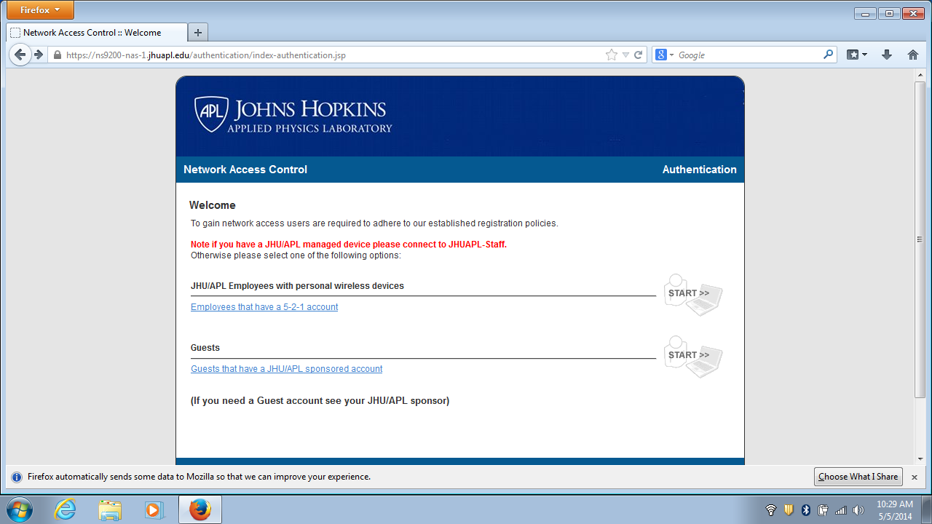
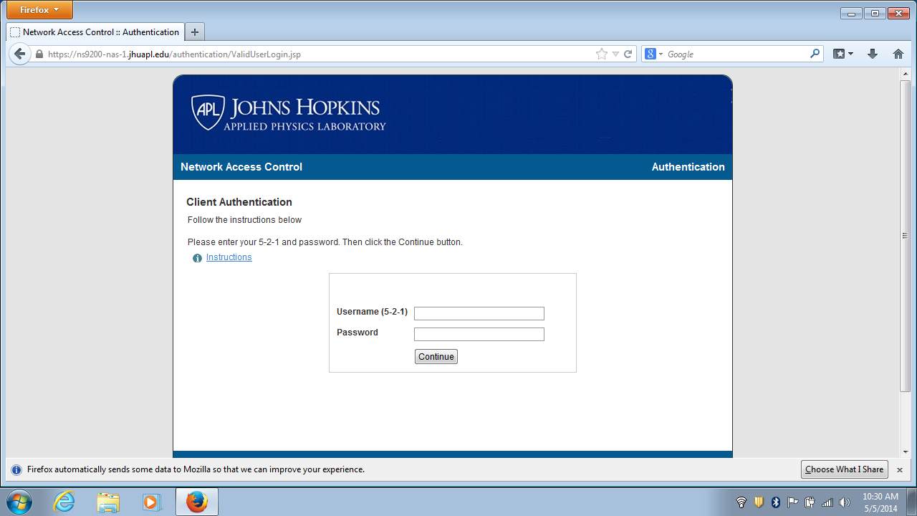
Wireless Information: Instructor-provided laptops
To log onto the guest network (JHUAPL-Guest) , open Firefox (or IE):
Type in google.com
1st screen: network access control page
click on 5-2-1 login (even though it says “JHU/APL Employees with personal wireless devices”)

Slide 6
Materials
Tangibles
☺ Teaching / Lab Assistants
Computer with Integrated Development Environment (IDE) and power for Arduino board.
Arduino Uno R3 board
Sunfounder Kit of electronic parts
USB cable (in Sunfounder Kit)
Hemostats for handling small parts
Salmon-colored anti-static pad
Intangibles
Instructor-provided laptops: Lessons and code are on your laptop
Student-provided laptops: Lessons and code were emailed to you
Lessons and code are also on SharePoint
https://aplworks/caig/ls/ArduinoIGMay2014/Main%20Track%202014%20Spring/Forms/AllItems.aspx
Acknowledgement: all tutorials courtesy Adafruit, Inc. and written by Simon Monk
Original full-length version of tutorials: http://learn.adafruit.com/adafruit-arduino-lesson-*

Slide 7
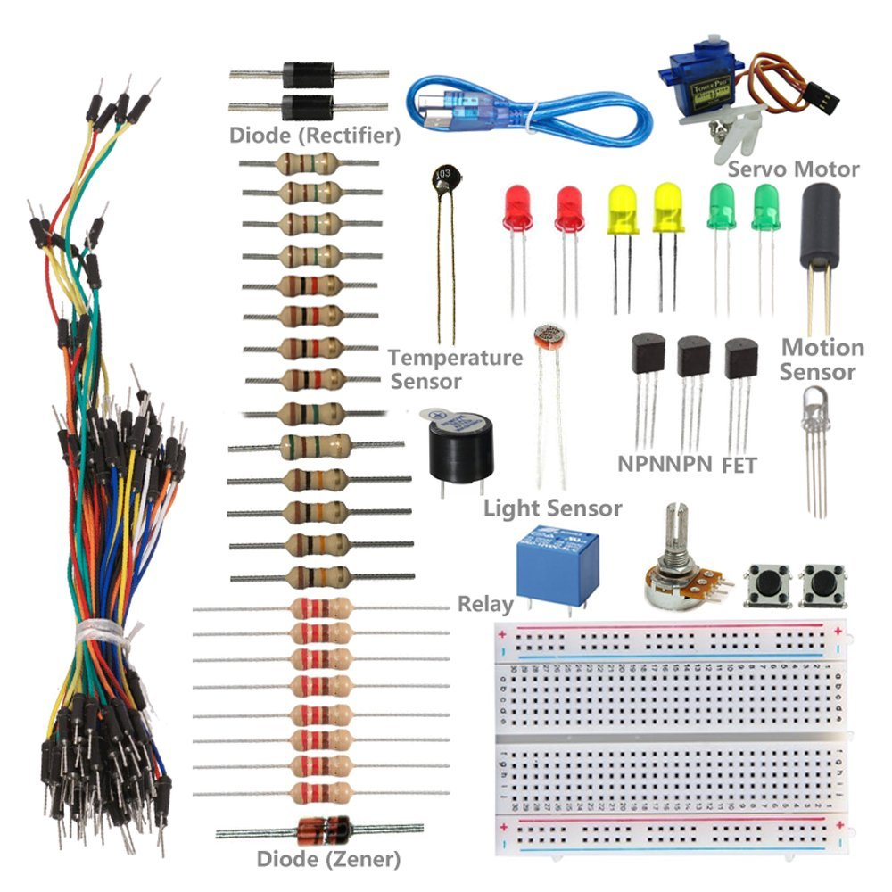
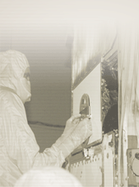
Sunfounder Kit Contents
RGB LED
Jumper wires
Buzzer
Potentiometer
Buttons
Breadboard
Notes:
Kit Contents:
1x USB Cable 1x Breadboard 1x Hookup Wire Set 1x Project Box 8x Resistor - 220R 4x Resistor - 1 kR 4x Resistor - 10 kR 4x Resistor - 100 kR 1x Resistor - 1 MR 1x Resistor - 5.1 MR 2x NPN Transistor 1x FET Power Transistor 2x Diode (Rectifier) 1x Diode (Zener) 1x Motion Sensor (Tilt Switch) 1x Light Sensor (Photocell) 1x Temperature Sensor 2x Button 1x Rotary Knob (Potentiometer) 1x Servo Motor 1x RGB LED 2x green LED 2x red LED 2x yellow LED 1x Piezo Buzzer/Speaker 1x Relay

Slide 8
ElectroStatic Discharge (ESD)
Be aware that you can build up static charge walking across a carpet, for example
Ground yourself by touching a grounded surface before touching the electronic parts to save their life
Recommendation: Work with Arduino and breadboard on the foam anti-static pad.
More information available at the end of the slide set

Slide 9
Lessons Covered¹
1. These lessons are from Simon Monk’s Arduino Tutorials on Adafruit.com. They are used with his permission and have been shared by Adafruit under a “Creative Commons” license.
2. These lessons have been modified for APL use since they depend on the Lesson 4 breadboard setup which we’re omitting because of it’s complexity.
Notes:
These lessons are from Simon Monk’s Arduino Tutorials on Adafruit.com. They are used with his permission and have been shared by Adafruit under a “Creative Commons” license.
These lessons have been modified for APL use since they depend on the Lesson 4 breadboard setup which we’re omitting because of it’s complexity.

Slide 10
Lesson Workflow
Setup* (Lesson 0)
Serial Monitor (Lesson 5 modified)
Sensing Light (Lesson 9)
Blink*
(Lesson 1)
Digital Inputs(Lesson 6)
Making Sound (Lesson 10)
LEDs
(Lesson 2)
Analog Inputs (Lesson 8)
Servo Motors (Lesson 14)
RGB LEDs (Lesson 3)
Optional:
Make an RGB LED Fader (Lesson 7)
*Partially done before the course if you brought your own laptop.
Notes:
*Most of Lessons 0 and 1 will be done before the course by the BYOD students. Estimate 5 minutes in class.
Recommended Procedure For Each Lesson:
Look at the slide (and listen to instructor)
Open the PDF for the Lesson (in the Arduino 101 directory)

Slide 11
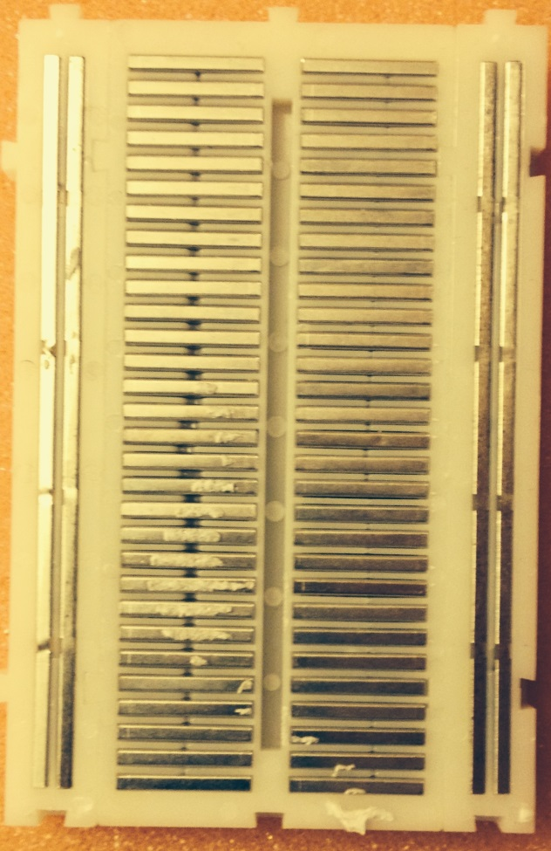
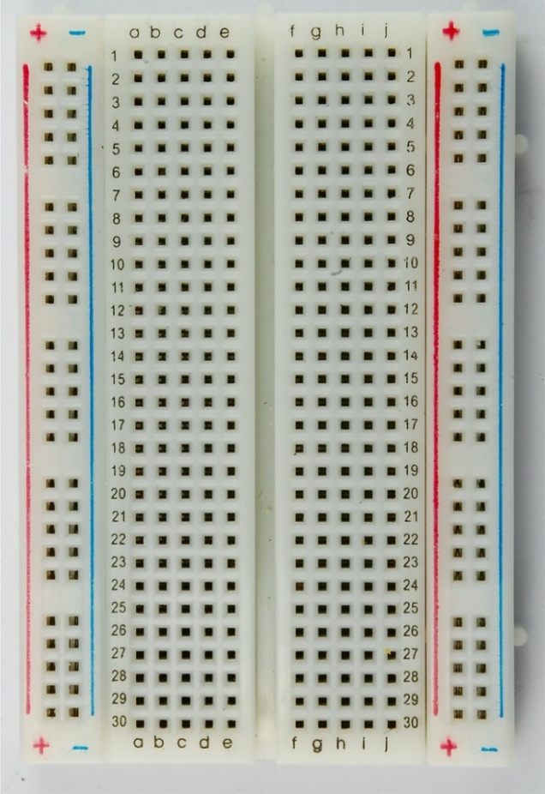
Lesson 0 - Getting Started
Most Lessons, including this one, have PDFs (in the Arduino 101 directory)
Your Arduino IDE is already set up. Verify setup of board and port used.
Breadboard: A tool for constructing electronics without soldering; used for prototyping.
row
Rail or column
Notes:
Instructor’s Notes to Self:
Installation of the Arduino IDE (done before class).
Have students put a piece of tape over the metal USB connector
Setup of board and port used (note: on Windows, ports 1 & 3 are “interchangeable”, and ports 2 & 4 are “interchangeable”).
Explanation of what a breadboard is.
Time estimate: 5 minutes.

Slide 12
Lesson 0, continued
Getting the Example Code into your Sketchbook
Programs called "Sketches"
Directory of Sketches called "SketchBook“
If example code is not already in your “Sketchbook”, copy everything in the Arduino 101\Sketches folder
Save code:
On Macs: save to Documents\Arduino
On Windows: save to My Documents\Arduino
Don’t make a folder – just put under “..Arduino”
Start the Arduino IDE to see the code in SketchBook
If needed, close IDE & restart
Beware: needs non-trivial directory structure and filename conventions, but IDE will prompt you to create the directory needed when saving a file

Slide 13
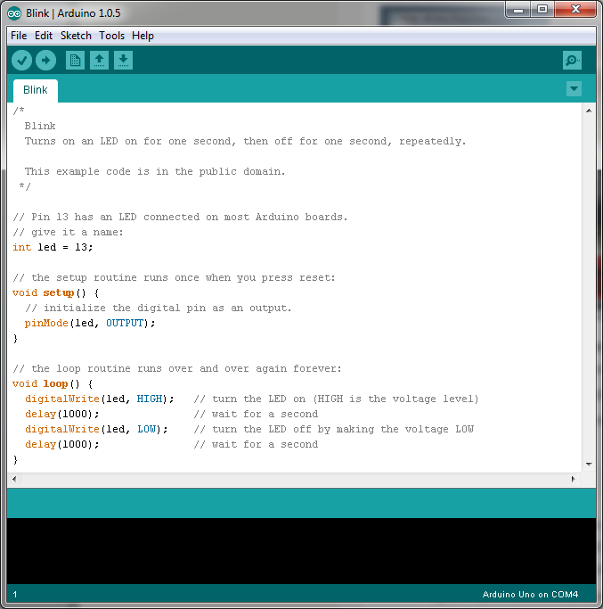
Lesson 1 - Blink
Upload Blink sketch to the Arduino.
Observe the “L” LED on your Arduino.
Modify Blink sketch to speed up (or slow down) blinking.
Notes:
Instructor’s Notes to Self:
Upload Blink sketch to the Arduino.
Walkthrough Blink sketch code.
Modify Blink sketch to speed up (or slow down) blinking.
Time estimate: 5 minutes.

Slide 14
Lesson 1 –Blink, Continued
// Pin 13 has an LED connected on most Arduino boards.
// give it a name:
int led = 13; // variable declarations
// the setup routine runs once when you press reset:
void setup() {
// initialize the digital pin as an output.
pinMode(led, OUTPUT);
}
// the loop routine runs over and over again forever:
void loop() {
digitalWrite(led, HIGH); // turn LED on (HIGH is voltage level)
delay(1000); // wait for a second
digitalWrite(led, LOW); // turn LED off by making voltage LOW
delay(1000); // wait for a second
}
Notes:
Instructor’s Notes to Self:
Upload Blink sketch to the Arduino.
Walkthrough Blink sketch code.
Modify Blink sketch to speed up (or slow down) blinking.
Time estimate: 5 minutes.

Slide 15
Lesson 2 -LEDs and Resistors
Issue: what resistor values needed / used for LEDs?
Concept
Given constant voltage – 5 volts for us – …
Smaller resistor gives brighter light
Too small resistor will cause LED to “burn out” permanently; in milliseconds
Resistor can be ∞, brightness will be zero
For 5 volts, minimum resistor is 150Ω
We will use 220Ω, since available in SunFounder Kit
Adafruit tutorials say to use 370Ω
No risk
SunFounder kit contains 8 220 Ω resistors & 4 1 kΩ Resistors – ignore all others in the kit
Recommendation: Learn resistor code.
Notes:
For later: Your kit contains 8x Resistor - 220R 4x Resistor - 1 kR 4x Resistor - 10 kR 4x Resistor - 100 kR 1x Resistor - 1 MR 1x Resistor - 5.1 MR
Recommendation: Learn resistor code.
Use a mnemonic that you wouldn’t be embarrassed to repeat in front of your kids/parents. Suggestion: Big boys race our young girls but Violet generally wins.

Slide 16
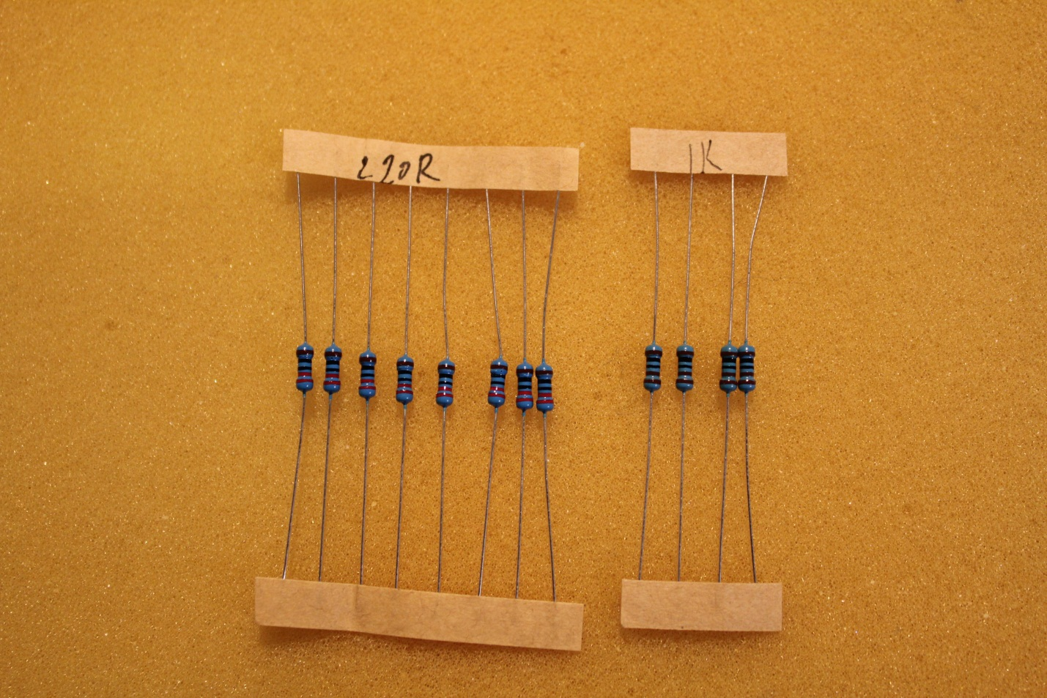
Lesson 2 - Resistors in Sunfounder Kit
The resistor values are written on the tape. The color bands are hard to read on 1/8 watt resistors.
Please locate your 220 Ω and 1 kΩ resistors now and keep them handy. These are the only ones we’ll use for the lessons.
220 Ω – red, red, black, black, brown
1 kΩ – brown, black, black, brown, brown

Slide 17
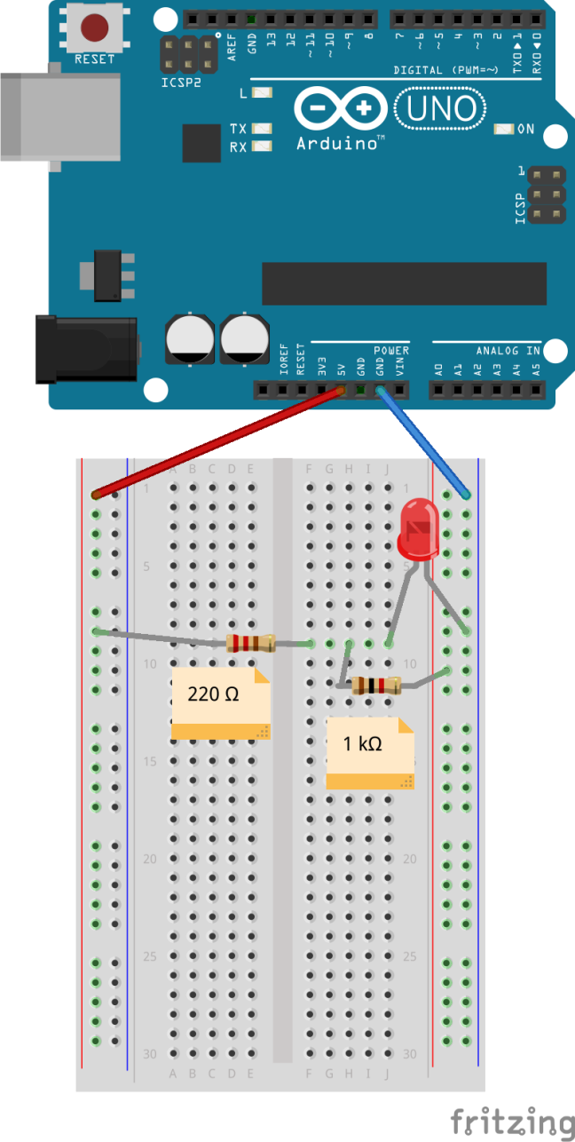
Lesson 2 – LEDs – Part 1
LEDs are directional
Be careful not to connect both red and blue wires to the same rail.
Use a resistor to prevent the LED burning out
Build project, showing the effects of the 2 different resistors used (220Ω & 1kΩ).
Start with breadboard layout shown here to see the effect of using the 220Ω resistor. Then, move the red jumper wire from the left power rail to the right power rail to see the effect of using the 1kΩ resistor instead.
Notes:
Instructor’s Notes to Self:
Discussion of LEDs and resistors.
Build project, showing the effects of the 2 different resistors used (220Ω & 1kΩ).
Use Blink sketch from Lesson 1
Time estimate: 5 minutes.

Slide 18
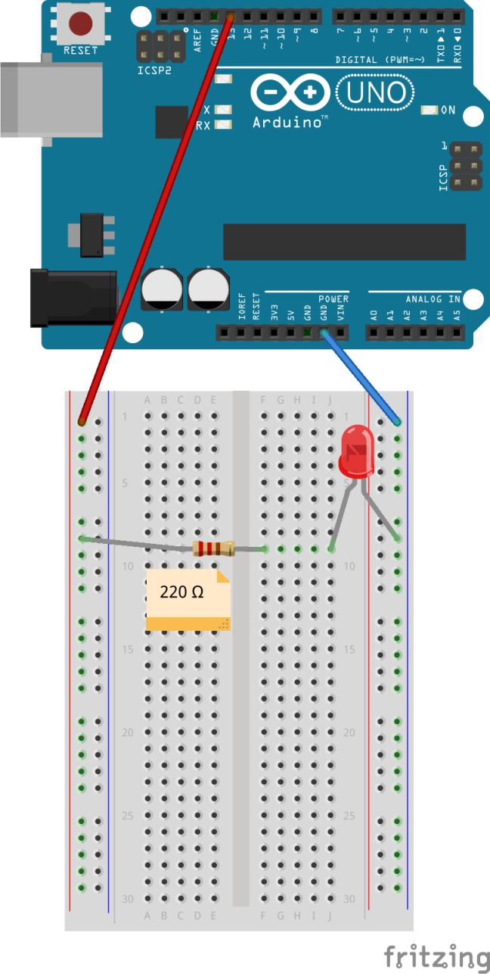
Lesson 2 – LED – Part 2
Then move jumper wire from 5V connector to D13, and use Blink sketch from Lesson 1.
You shouldn’t need to upload the Blink sketch again.
Note that if you moved the red jumper wire to another output pin (say, D7) and changed the value of pin in the sketch from 13 to 7, the result would be the same.
Notes:
Instructor’s Notes to Self:
Discussion of LEDs and resistors.
Build project, showing the effects of the 2 different resistors used (220Ω & 1kΩ).
Use Blink sketch from Lesson 1
Time estimate: 5 minutes.

Slide 19
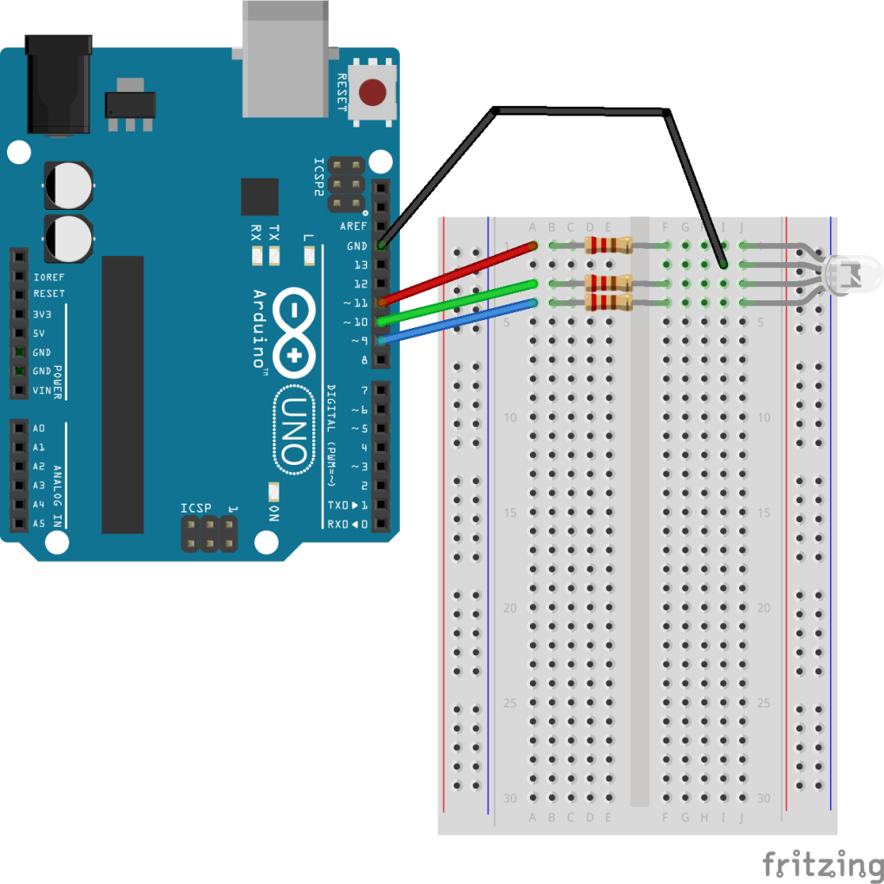
Lesson 3 – RGB LEDs
Use 3 resistors @ 220 Ω each
pseudo-analog output, aka PWM to control the brightness of the LEDs
RGB
Don’t disconnect anything – we’ll use the same layout in the next lesson ☺
Notes:
Instructor’s Notes to Self:
Discussion of pseudo-analog output, aka PWM ..
The RGB LED in your kit is common cathode
Discussion of RGB?
Do NOT use new “RGB LED” sketch
Use 3 resistors @ 220 Ω each
Time estimate: 7 minutes.

Slide 20
Lesson 5 – Serial Monitor (Modified)
Use the Lesson 5 sketch to extend the RGB LED lesson to use the Serial Monitor.
There is no PDF file corresponding to the modified lesson.
The breadboard layout is identical to Lesson 3.
Serial is a built-in library.
Note: The serial port communicates on D0 (RX) and D1 (TX) as well as with the computer via the USB. So, you cannot use D0 and D1 for digital I/O at the same time as Serial.
Click on the magnifying glass symbol (upper right of your IDE window) to open the Serial Monitor.
The Serial Monitor is useful for debugging.
Notes:
Instructor’s Notes to Self:
Use Mars’ script to extend the RGB LED lesson to use the Serial Monitor.
Point out the utility of the Serial Monitor for debugging.
Time estimate: 5 minutes.

Slide 21
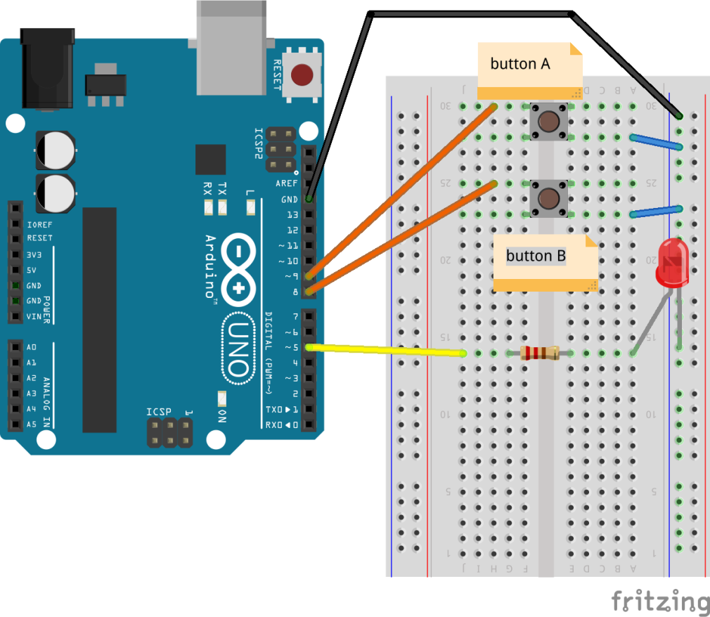
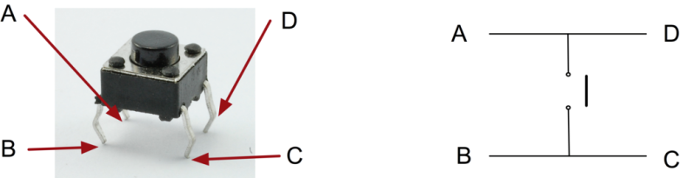
Lesson 6 – Digital Inputs
Demonstrates use of digital inputs using pushbuttons.
Follow breadboard setup (leverage lesson 2 if it has not been torn apart).
Notes:
Instructor’s Notes to Self:
Demonstrate use of digital inputs using pushbuttons.
Follow breadboard setup (leverage lesson 2 if it has not been torn apart).
Upload code & walk through briefly.
Point out the diagram of the pushbuttons (push switches) that Monk provides.
Time estimate: 10 minutes.

Slide 22
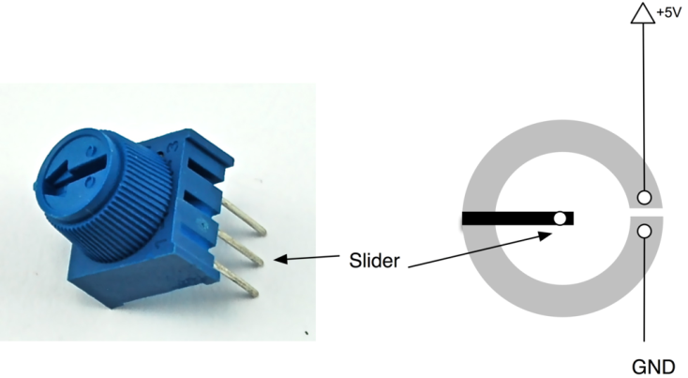
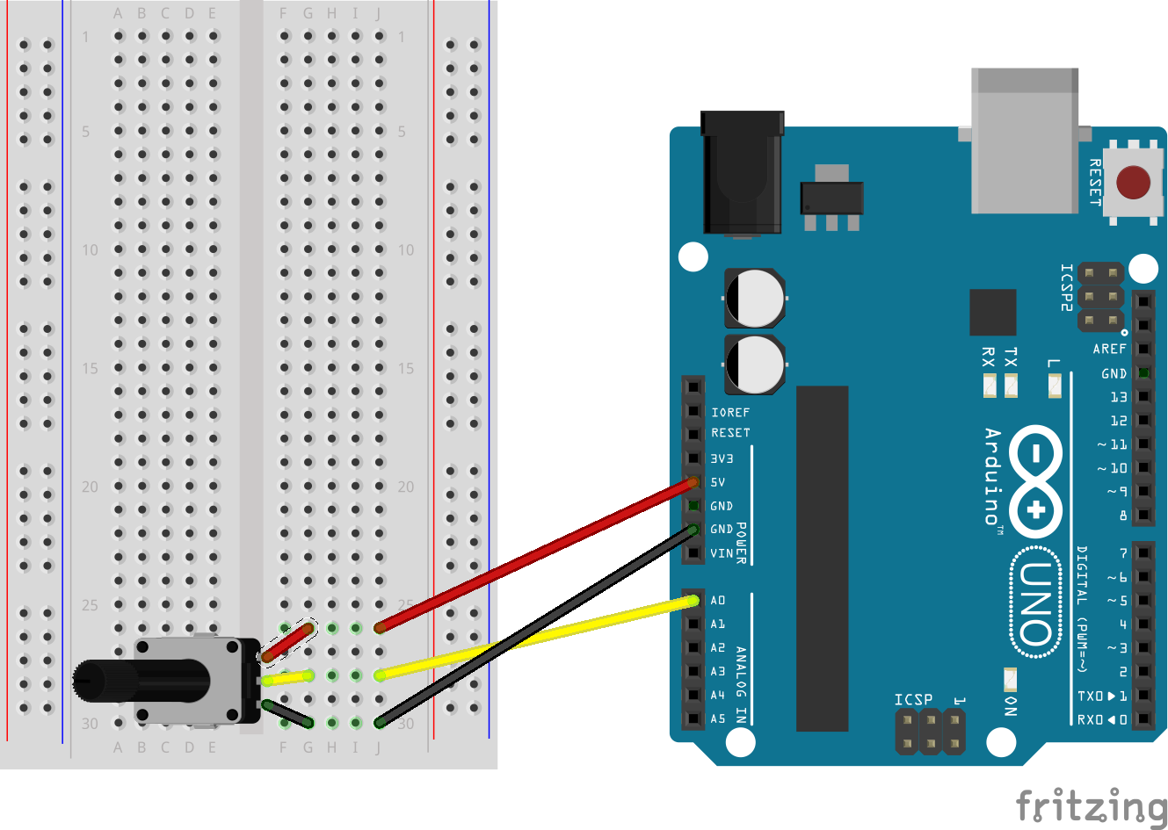
Lesson 8 - Analog Input (Modified)
We’re only covering Monk’s “An Experiment” section
Uses "potentiometer" ("pot")
Only sketch is “Adafruit_08a.ino”
Notes:
Instructor’s Notes to Self:
Only cover “An Experiment” and “Variable Resistors (Pots)” sections from the Lesson PDF.
Sample code demonstrates the utility of the Serial Monitor for debugging.
Description of pots is useful.
Time estimate: 5 minutes.

Slide 23
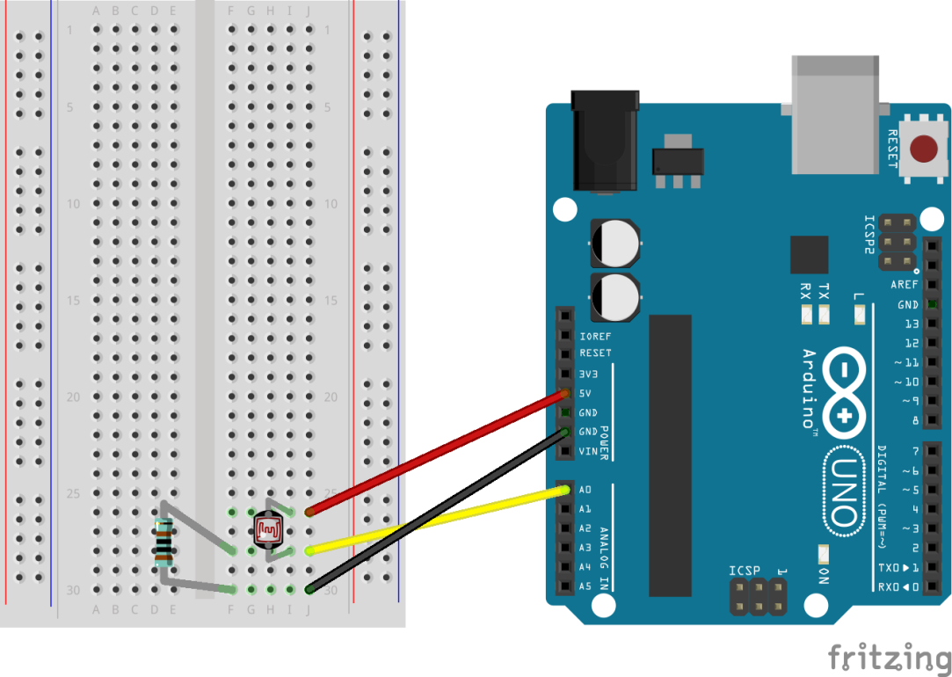
Lesson 9 – Sensing Light
Replace the pot from the lesson 8 with the light sensor and 1K resistor, as described on page 6 of the Lesson 9 PDF.
Do not put light sensor alone between +5 and GND
The only sections of the Lesson 9 PDF to be covered are “Breadboard Layout” and “Photocells”.
Use sketch from Lesson 8 to display the light sensor’s measurement in the Serial Monitor.
Don’t use sketch labelled as Lesson 9.
Notes:
Instructor’s Notes to Self:
Replace the pot from the lesson 8 “experiment” with the light sensor and 1K resistor, as described on page 6 of the Lesson 9 PDF.
Do not put light sensor alone between +5 and GND
The only sections of the Lesson 9 PDF to be covered are “Breadboard Layout” and “Photocells”.
Use sketch from Lesson 8 “Experiment” to display the light sensor’s measurement in the Serial Monitor.
Time estimate: 5 minutes.
Typical values: ambient => 890..896; finger on top => 583; pinch edges, too => 382.
Beware: spectral response of sensors, including human eye, may be important for your application.
Also see http://learn.adafruit.com/photocells?view=all
Further work: use “map” to extend range from 0 to 1023.

Slide 24
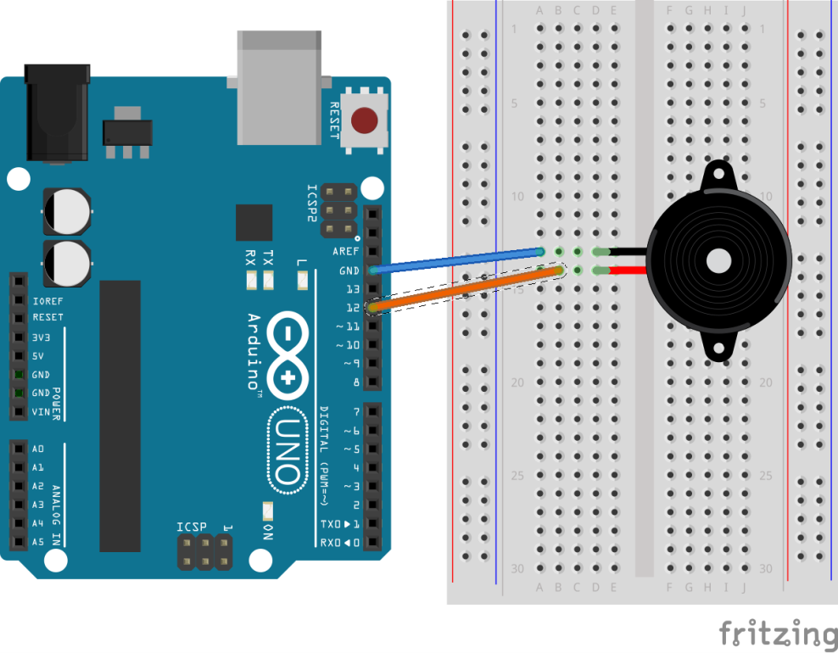
Lesson 10 – Making Sounds
Make sounds using the Arduino with a piezoelectric buzzer.
Very simple breadboard setup.
Buzzer is directional: + sign on the top marks the + lead.
Simple script plays a scale once and “stops”.
To play it again, press the reset button.
Notes:
Instructor’s Notes to Self:
Make sounds using the Arduino with a piezoelectric buzzer.
Very simple breadboard setup.
Simple script plays a scale.
Skip Pseudo-Theremin due to time constraints? But this part is interactive.
Time estimate: 5 minutes.

Slide 25
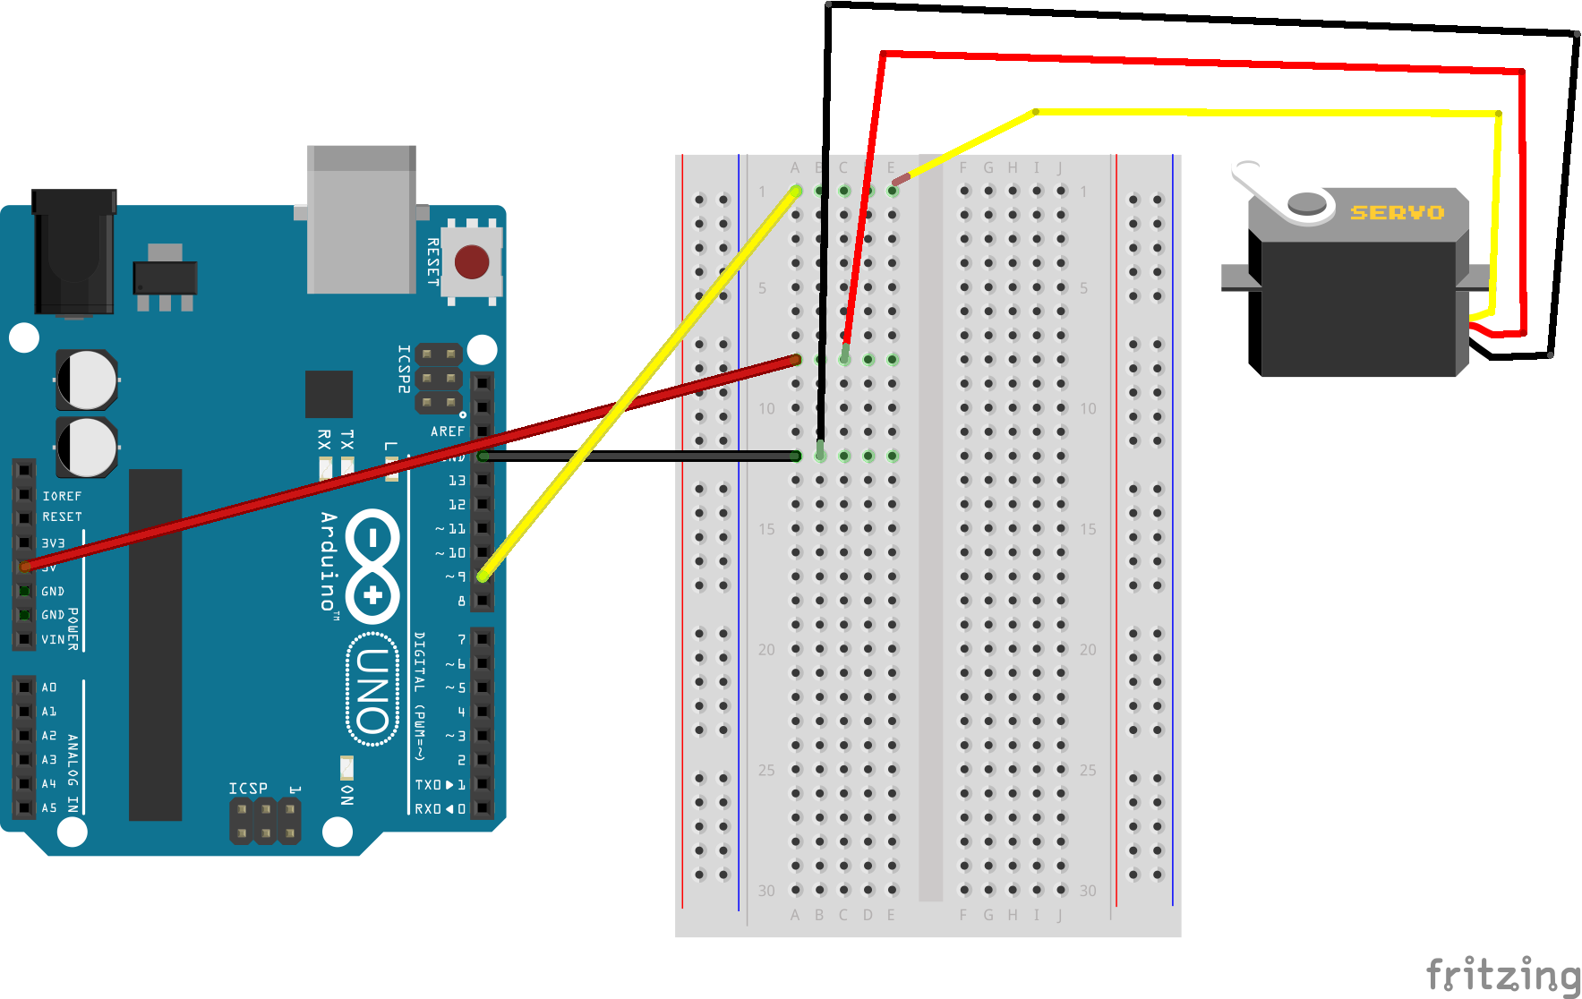
Lesson 14 – Servo Motors – Part A: Sweep
Use a friction fit instead of screw for the motor fan blade.
For this lesson, spacing is important. Leave 3 rows in between the black and red jumper wires.
Leads on your motor: brown is GND, orange is 5V, yellow is control.
Push jumper wires into socket that the leads terminate at.
Notes:
Instructor’s Notes to Self:
Advantage to doing this: this is the only motor we have in the kit and it’d be nice to have the students work with at least one.
Disadvantages: - students have to put together the motors ( a couple of screws involved )
If we choose to show Monk’s video, note that it is not in the PDF.
Alternative: build a couple, with batteries, and pass around the rooms.
Time estimate: 15 minutes.

Slide 26
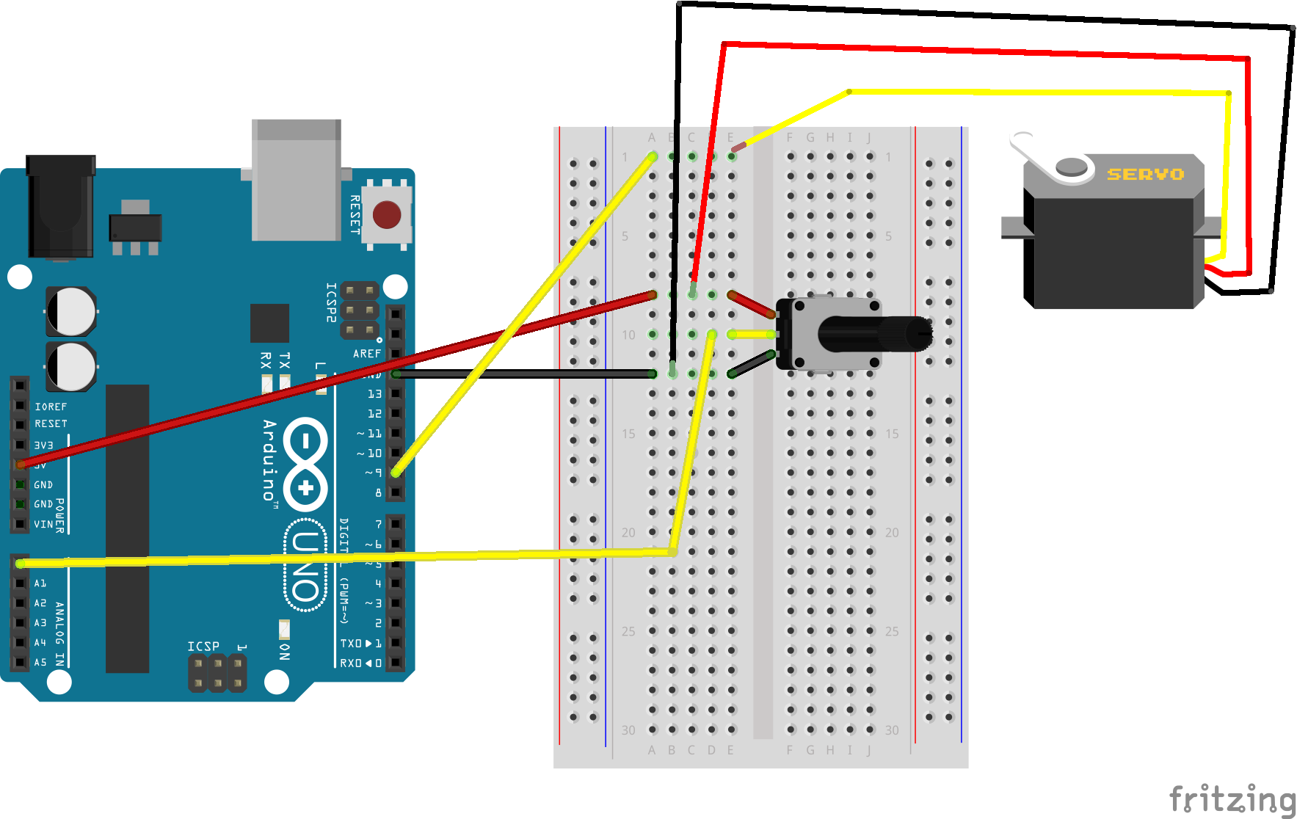
Lesson 14 – Servo Motors – Part B: Knob
Using the breadboard configuration from 14A, just add the pot and a lead from its slider to A0 on the Arduino.
Notes:
Instructor’s Notes to Self:
Advantage to doing this: this is the only motor we have in the kit and it’d be nice to have the students work with at least one.
Disadvantages: - students have to put together the motors ( a couple of screws involved )
If we choose to show Monk’s video, note that it is not in the PDF.
Alternative: build a couple, with batteries, and pass around the rooms.
Time estimate: 15 minutes.

Slide 27
Summary
You should now know
How to use the Arduino
For digital input & digital output
For analog input & (pseudo) analog output
How to use the associated Integrated Development Environment (IDE)
How to pass data between the Arduino and host computer
You should have seeds of ideas for
How to combine these elementary capabilities
How the Arduino family can be useful for your funded and unfunded goals

Slide 28
Appendix
Supplementary Material

Slide 29
Caveats/Gotchas
Insulate USB connector case with tape to avoid shorting out board when using shields.
Breadboard connections: may need to wiggle wires or even move to a different row on the breadboard to get a connection.

Slide 30
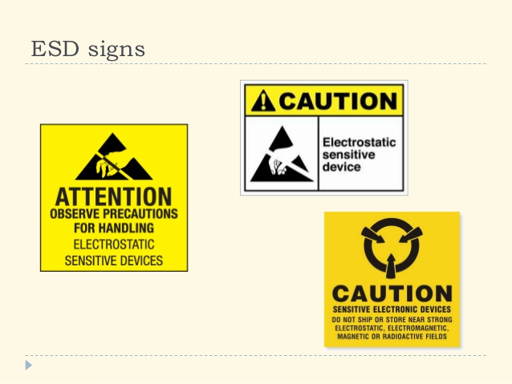
ElectroStatic Discharge (p1 of 4)
Slides courtesy http://www.slideshare.net/lpapadop/electrostatic-sensitive-devices; found 3/6/2014 3:27 PM

Slide 31
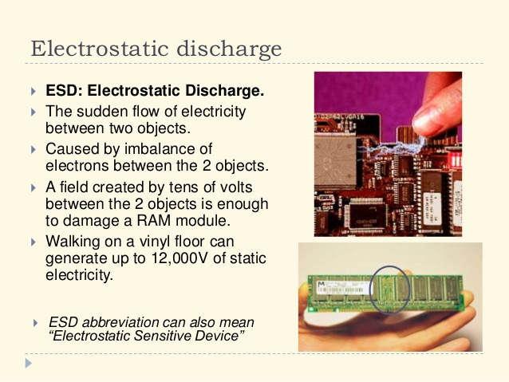
ElectroStatic Discharge (p2 of 4)

Slide 32
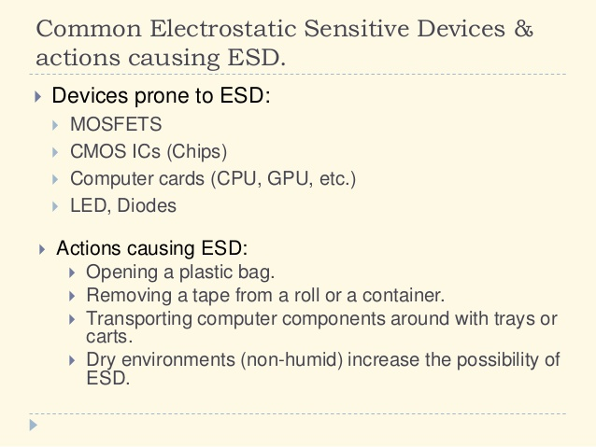
ElectroStatic Discharge (p3 of 4)

Slide 33
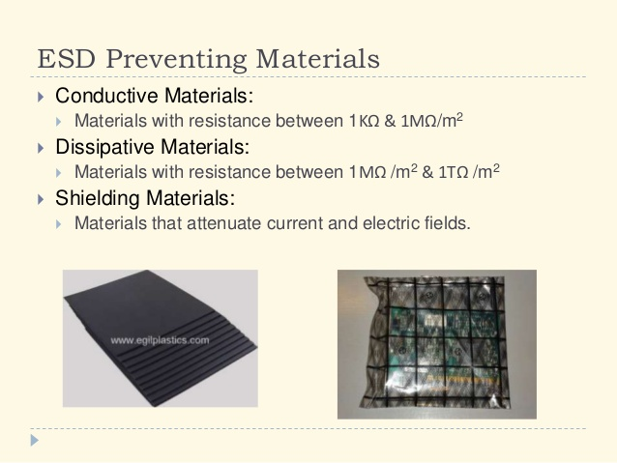

ElectroStatic Discharge (p4 of 4)
More at http://www.ruggedcircuits.com/10-ways-to-destroy-an-arduino

Slide 34
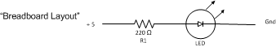
Lesson 2 – LED – Schematic
Notes:
Instructor’s Notes to Self:
Discussion of LEDs and resistors.
Build project, showing the effects of the 2 different resistors used (220Ω & 1kΩ).
Use Blink sketch from Lesson 1
Time estimate: 5 minutes.

Slide 35
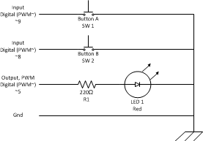
Lesson 6 – Digital Inputs
Notes:
Instructor’s Notes to Self:
Demonstrate use of digital inputs using pushbuttons.
Follow breadboard setup (leverage lesson 2 if it has not been torn apart).
Upload code & walk through briefly.
Point out the diagram of the pushbuttons (push switches) that Monk provides.
Time estimate: 10 minutes.

